Slide 1

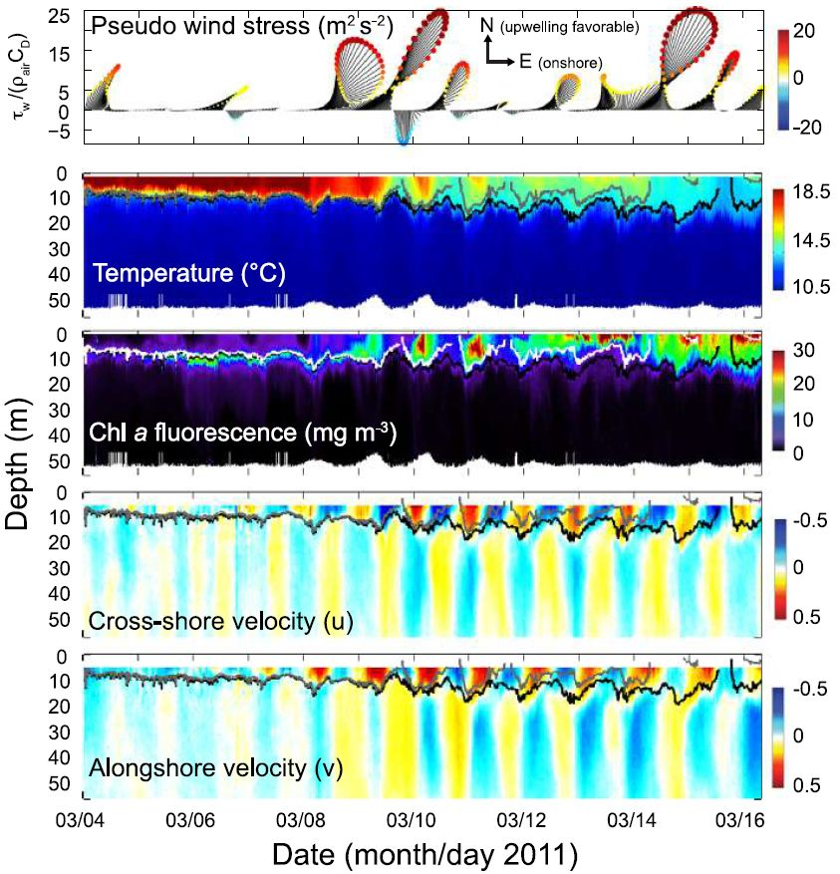
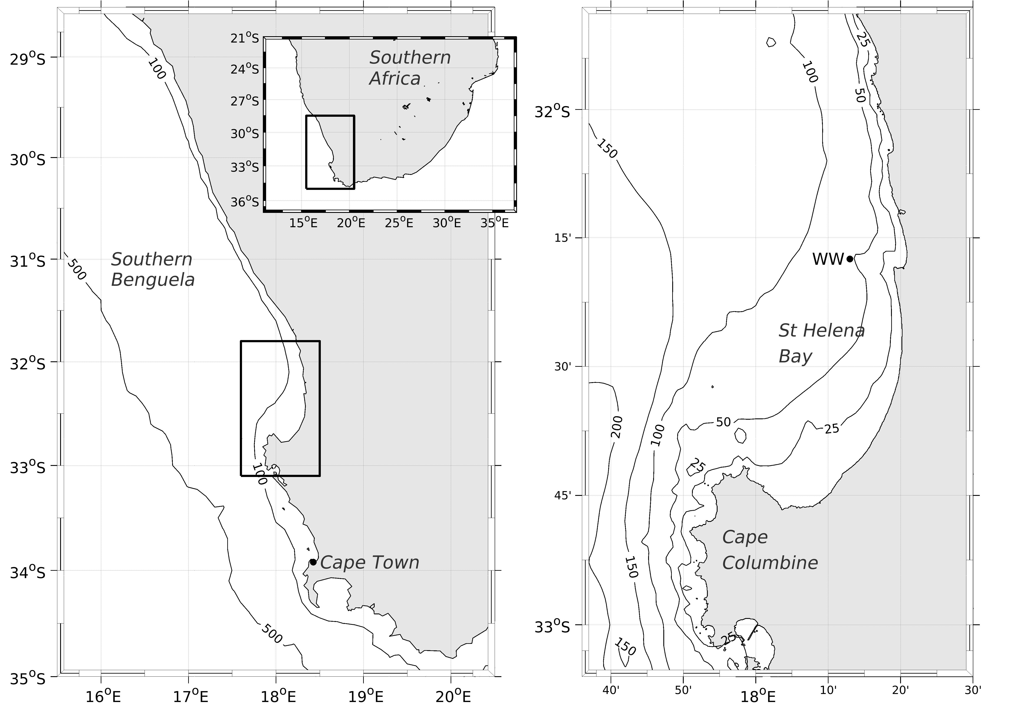

Slide 2

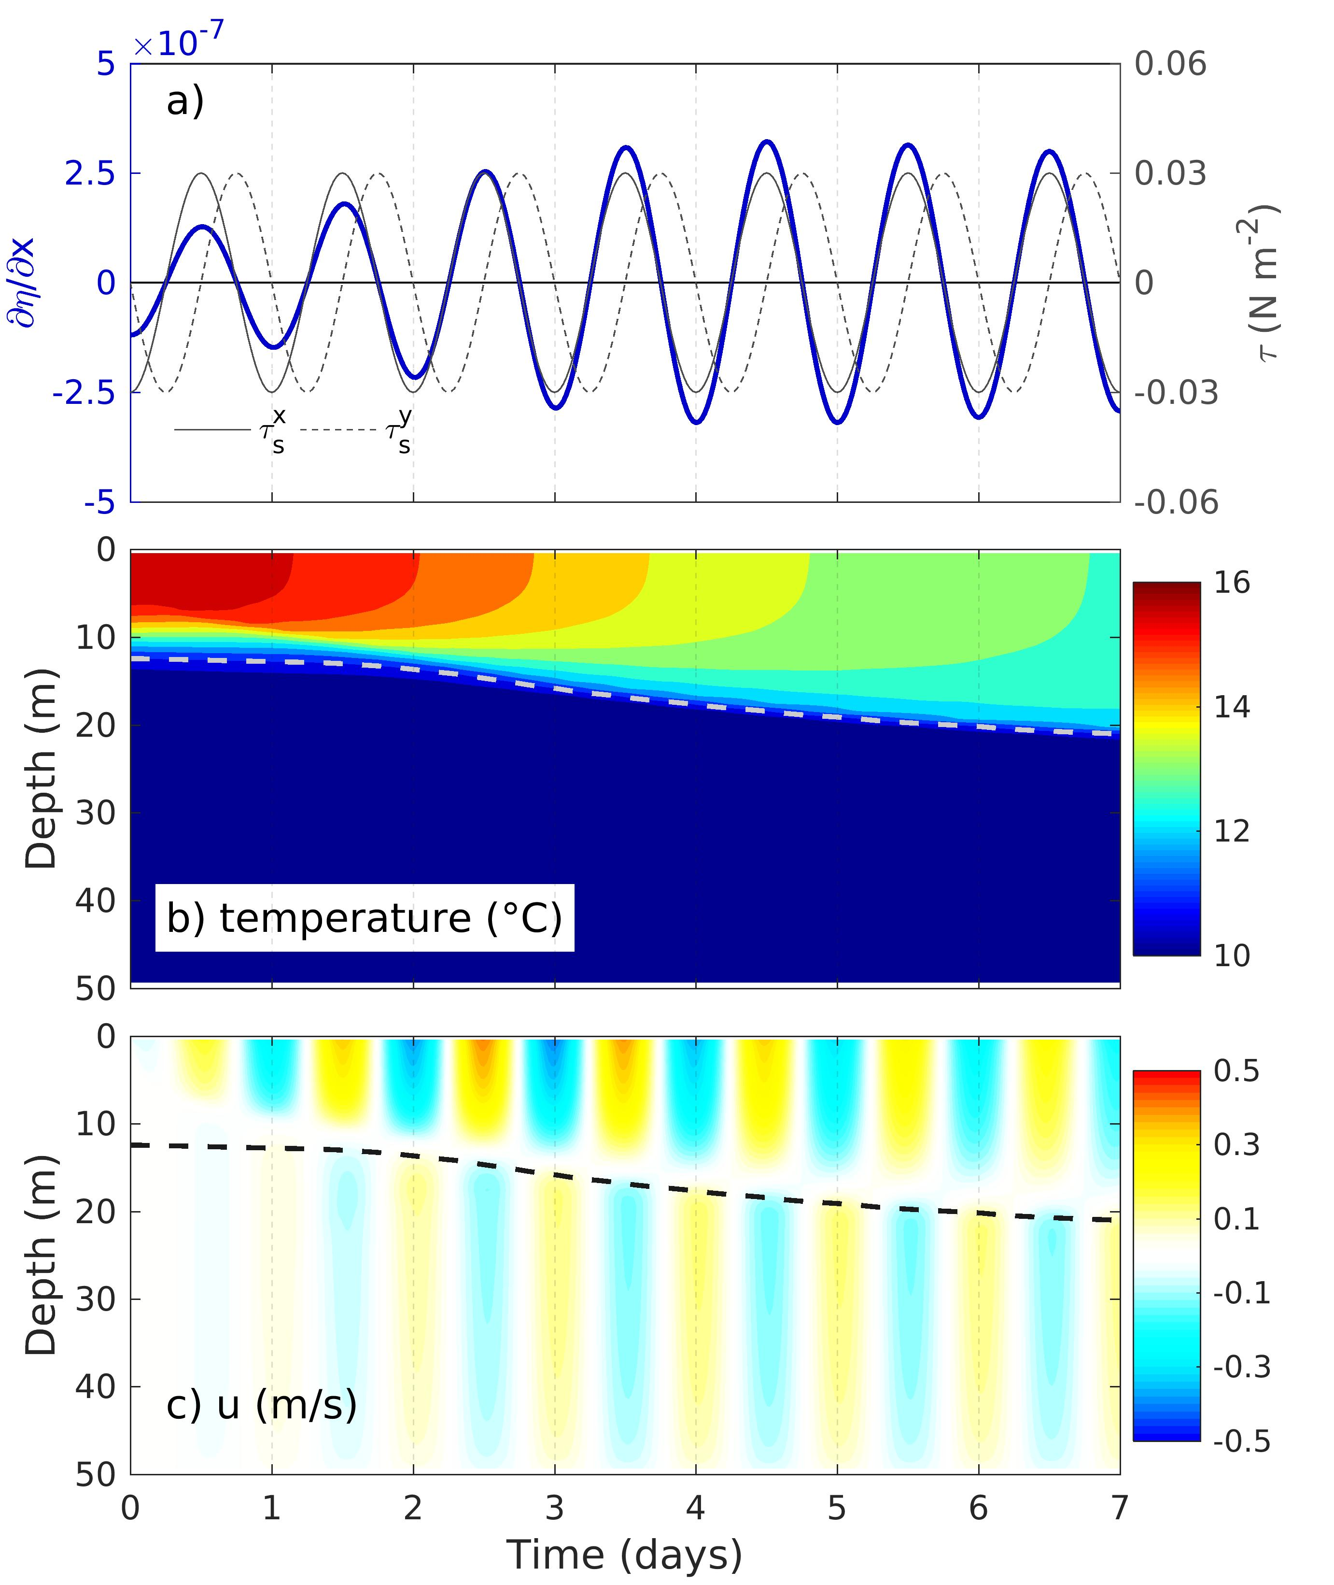
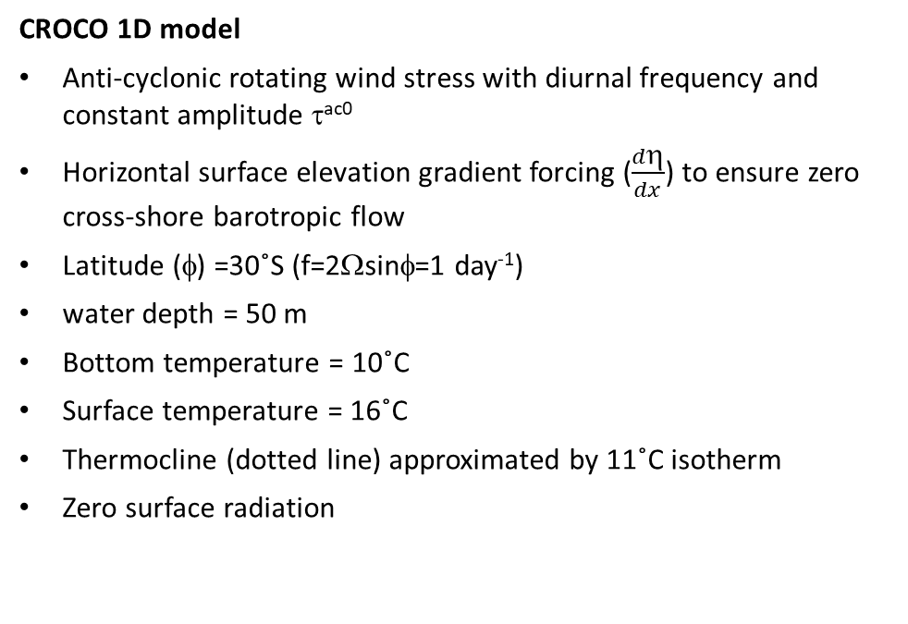
CROCO 1D model
Anti-cyclonic rotating wind stress with diurnal frequency and constant amplitude τ^{ac0}
Horizontal surface elevation gradient forcing ($\frac{dη}{dx}$) to ensure zero cross-shore barotropic flow
Latitude (φ) =30˚S (f=2Ωsinφ=1 day⁻¹)
water depth = 50 m
Bottom temperature = 10˚C
Surface temperature = 16˚C
Thermocline (dotted line) approximated by 11˚C isotherm
Zero surface radiation

Slide 3
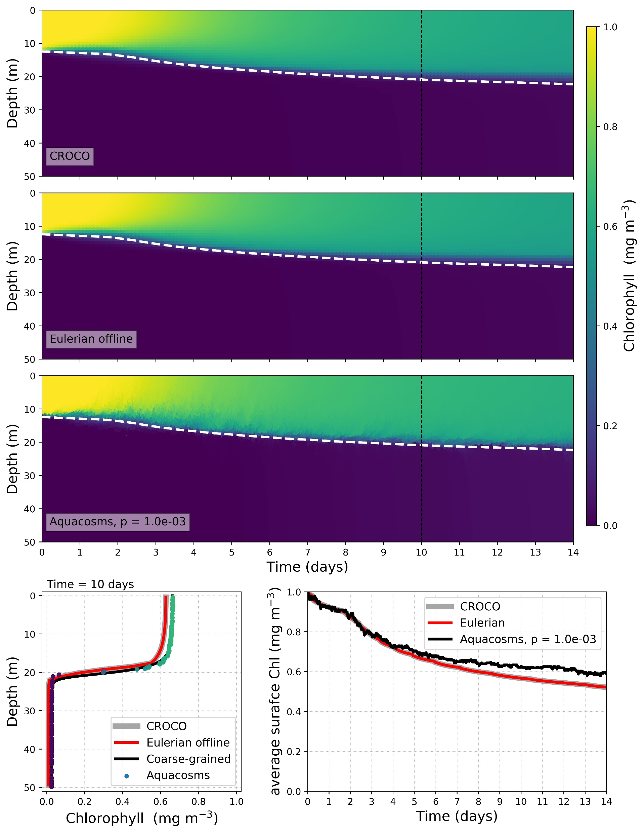
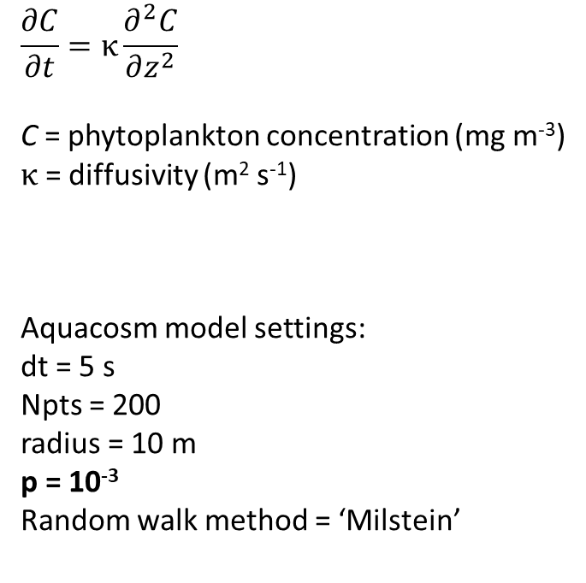
No Reactions
τ^{ac0} = 0.03 N m⁻²
Initial Chl condition – 1 mg m⁻³ in surface layer, 0 mg m⁻³ in subsurface
$$\frac{∂C}{∂t}=κ\frac{∂^{2}C}{∂z^{2}}$$
C = phytoplankton concentration (mg m⁻³)
$κ$ = diffusivity (m² s⁻¹)
Aquacosm model settings:
dt = 5 s
Npts = 200
radius = 10 m
p = 10⁻³
Random walk method = ‘Milstein’

Slide 4
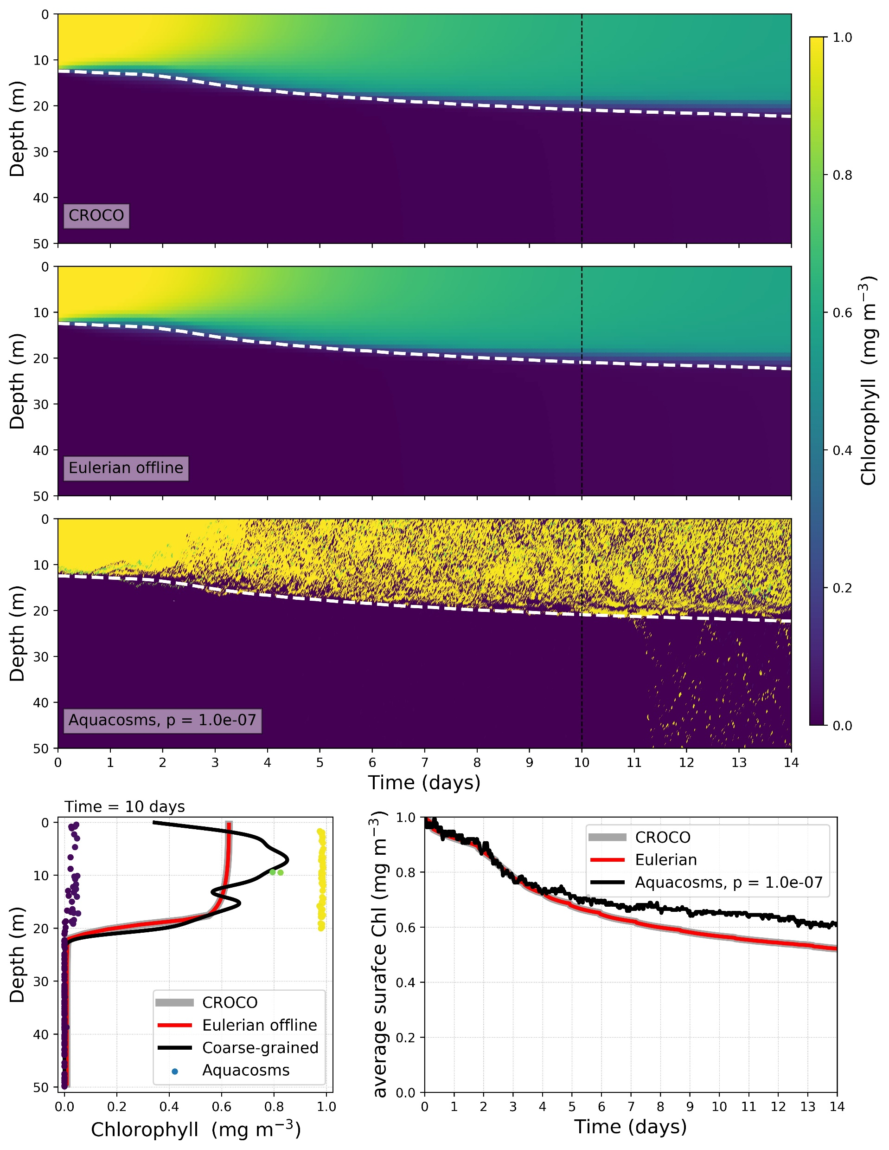
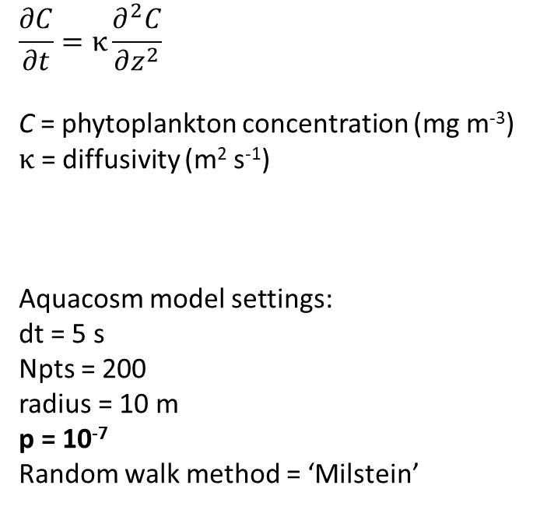
No Reactions
τ^{ac0} = 0.03 N m⁻²
Initial Chl condition – 1 mg m⁻³ in surface layer, 0 mg m⁻³ in subsurface
$$\frac{∂C}{∂t}=κ\frac{∂^{2}C}{∂z^{2}}$$
C = phytoplankton concentration (mg m⁻³)
$κ$ = diffusivity (m² s⁻¹)
Aquacosm model settings:
dt = 5 s
Npts = 200
radius = 10 m
p = 10⁻⁷
Random walk method = ‘Milstein’

Slide 5
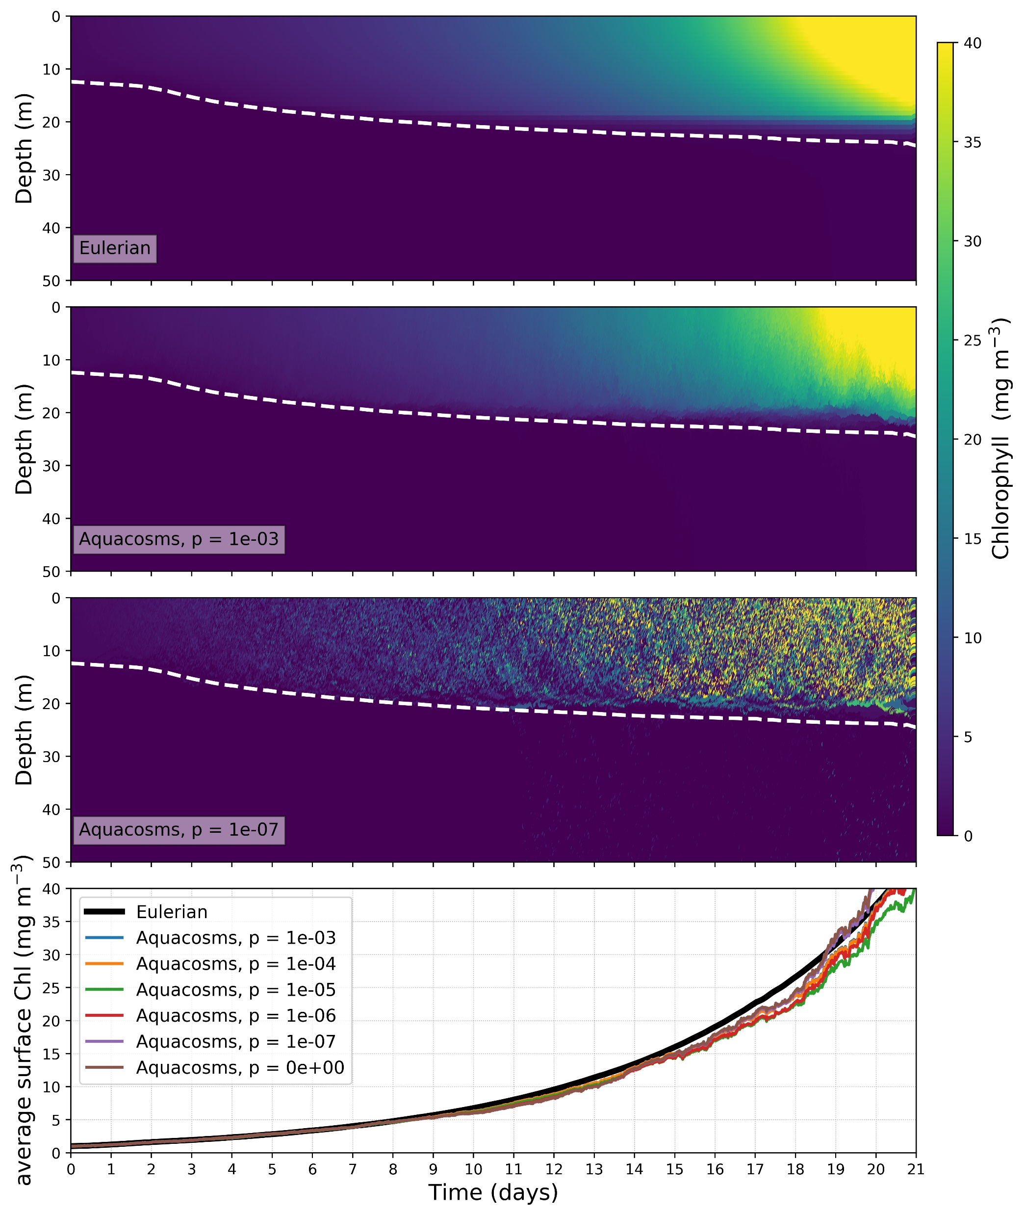
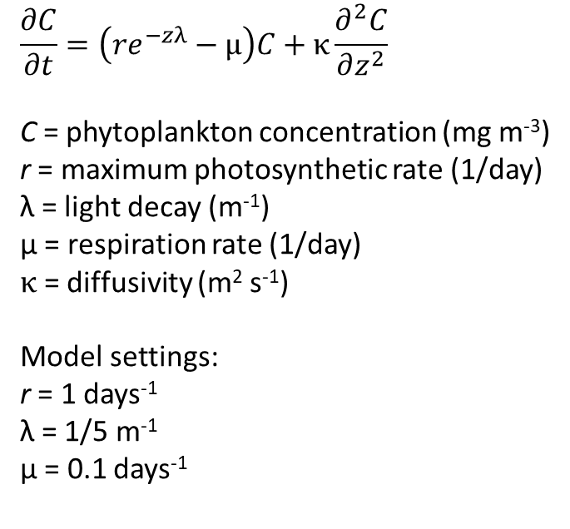
Sverdrup
τ^{ac0} = 0.03 N m⁻²
Initial Chl condition – 1 mg m⁻³ in surface layer, 0 mg m⁻³ in subsurface
$$\frac{∂C}{∂t}=\left(re^{−zλ}−μ\right)C+κ\frac{∂^{2}C}{∂z^{2}}$$
C = phytoplankton concentration (mg m⁻³)
r = maximum photosynthetic rate (1/day)
λ = light decay (m⁻¹)
μ = respiration rate (1/day)
$κ$ = diffusivity (m² s⁻¹)
Model settings:
r = 1 days⁻¹
λ = 1/5 m⁻¹
μ = 0.1 days⁻¹

Slide 6
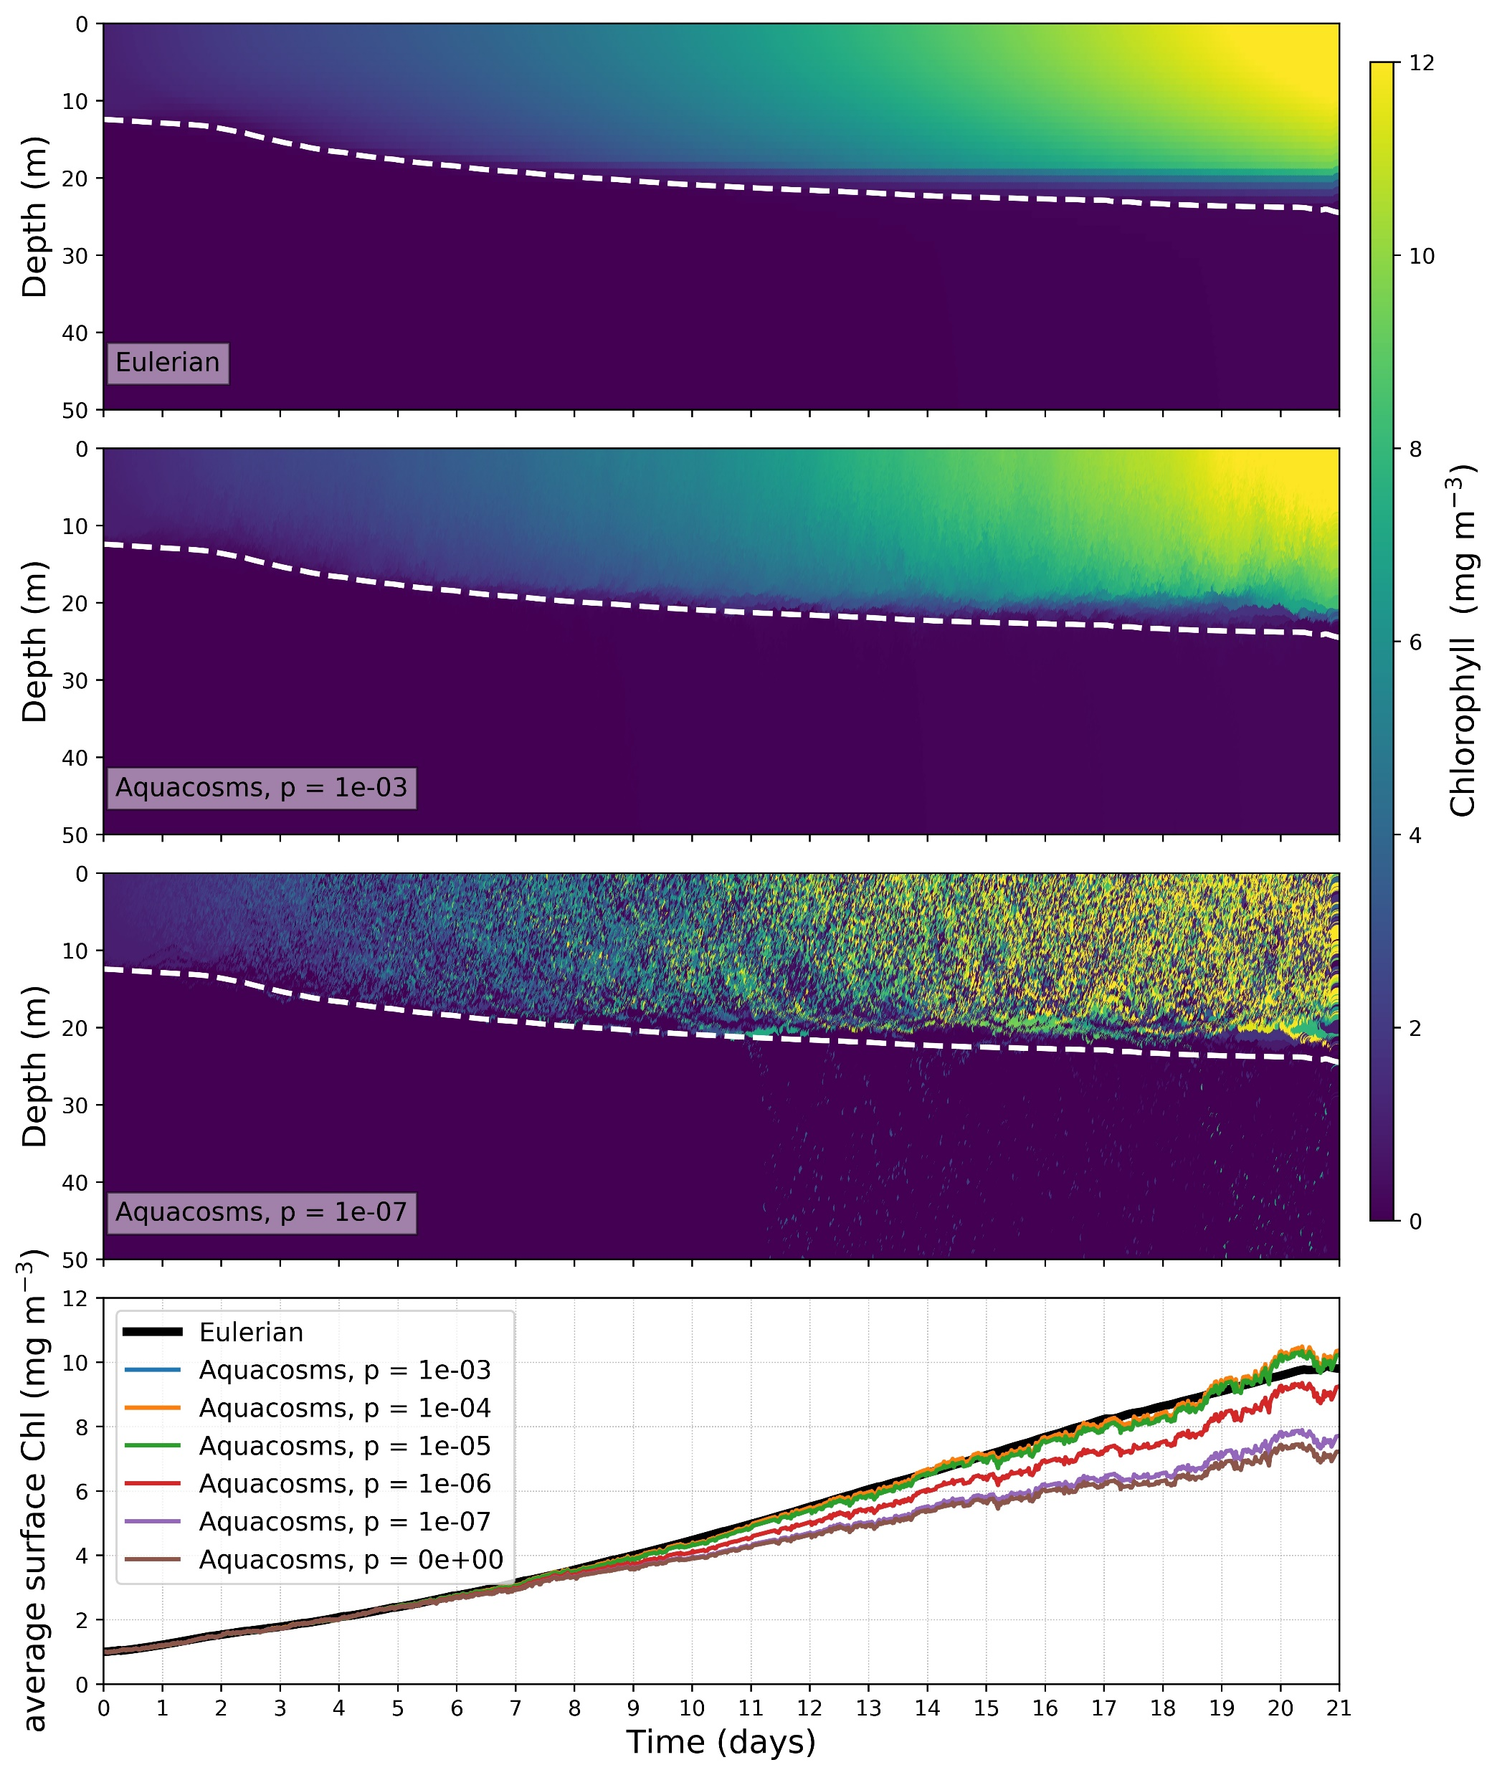
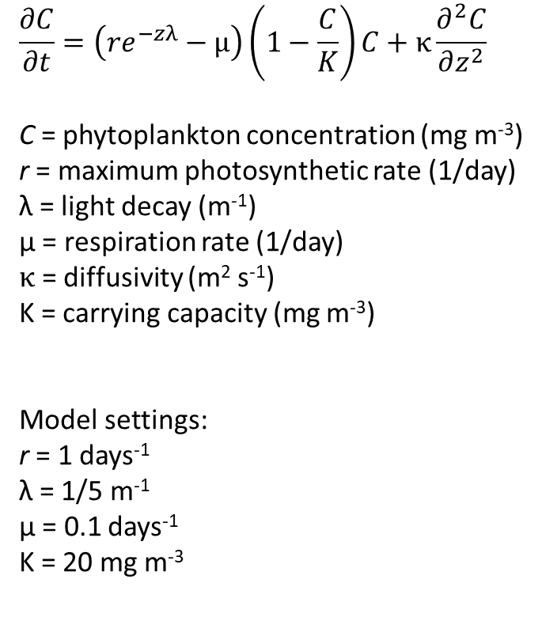
Sverdrup with carrying capacity
τ^{ac0} = 0.03 N m⁻²
Initial Chl condition – 1 mg m⁻³ in surface layer, 0 mg m⁻³ in subsurface
$$\frac{∂C}{∂t}=\left(re^{−zλ}−μ\right)\left(1−\frac{C}{K}\right)C+κ\frac{∂^{2}C}{∂z^{2}}$$
C = phytoplankton concentration (mg m⁻³)
r = maximum photosynthetic rate (1/day)
λ = light decay (m⁻¹)
μ = respiration rate (1/day)
$κ$ = diffusivity (m² s⁻¹)
K = carrying capacity (mg m⁻³)
Model settings:
r = 1 days⁻¹
λ = 1/5 m⁻¹
μ = 0.1 days⁻¹
K = 20 mg m⁻³
Notes:
Divergence of aquacosm and eulerian simulations kicks in as the effect of the carrying capacity kicks in
Particles which spend more time closer to the surface approach carrying capacity faster and growth slows down, so overall growth is less

Slide 7
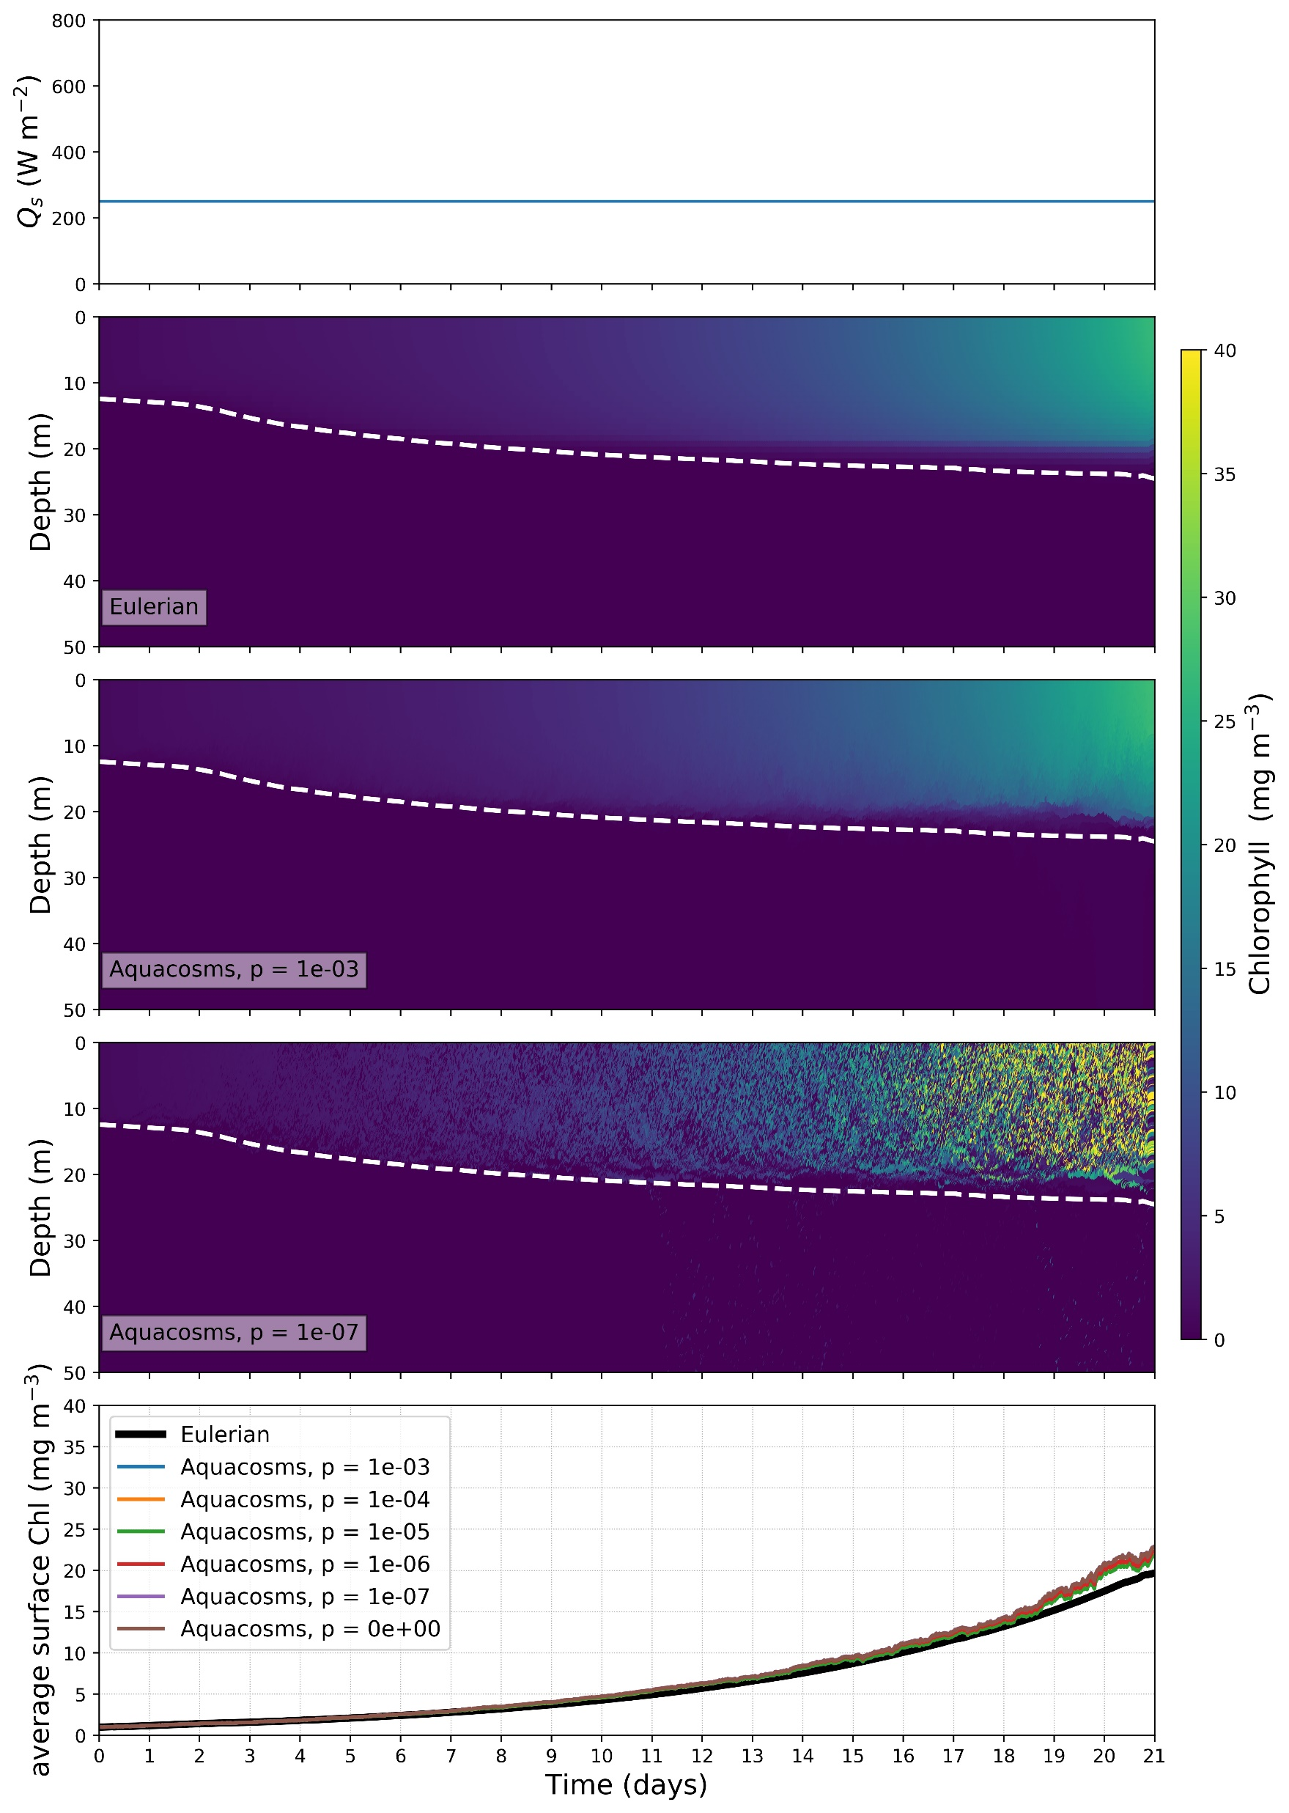
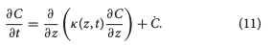
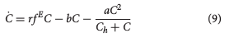
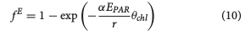
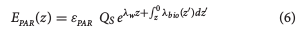
τ^{ac0} = 0.03 N m⁻²
BioShading_onlyC
Initial Chl (L) condition – 1 mg m⁻³ in surface layer, 0 mg m⁻³ in subsurface. Initial Carbon (C) = L / θ_{chl}
where
where
where
where
Model settings:
θ_{chl} = 0.017
r = 0.5 days⁻¹
λ_{w} = 1/5 m⁻¹ (as per Sverdrup experiments)
c = 0 m² mg chl⁻¹ (i.e. no bioshading)
b = 0.16 days⁻¹
a = 0.1 days⁻¹
,

Slide 8
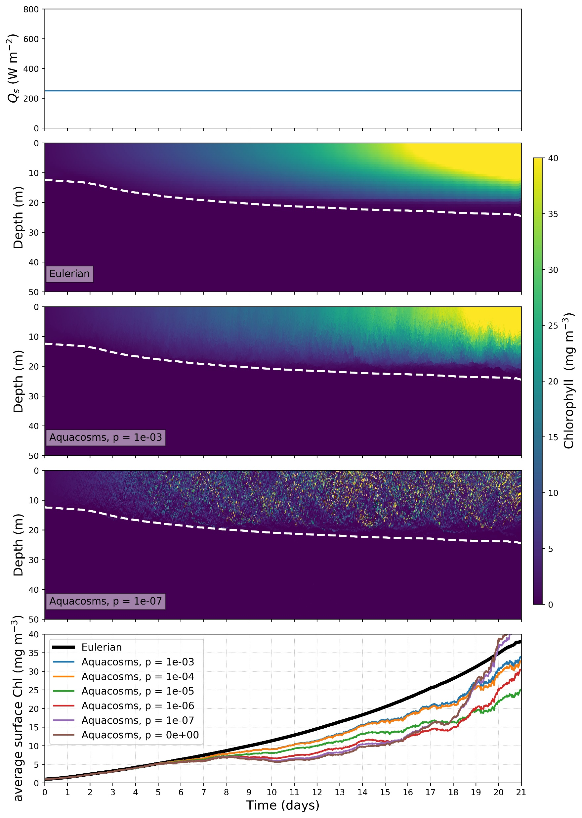
τ^{ac0} = 0.03 N m⁻²
BioShading_onlyC
Initial Chl (L) condition – 1 mg m⁻³ in surface layer, 0 mg m⁻³ in subsurface. Initial Carbon (C) = L / θ_{chl}
where
where
where
where
Model settings:
θ_{chl} = 0.017
r = 2 days⁻¹
λ_{w} = 1/5 m⁻¹ (as per Sverdrup experiments)
c = 0 m² mg chl⁻¹ (i.e. no bioshading)
b = 0.16 days⁻¹
a = 1 days⁻¹
,

Slide 9
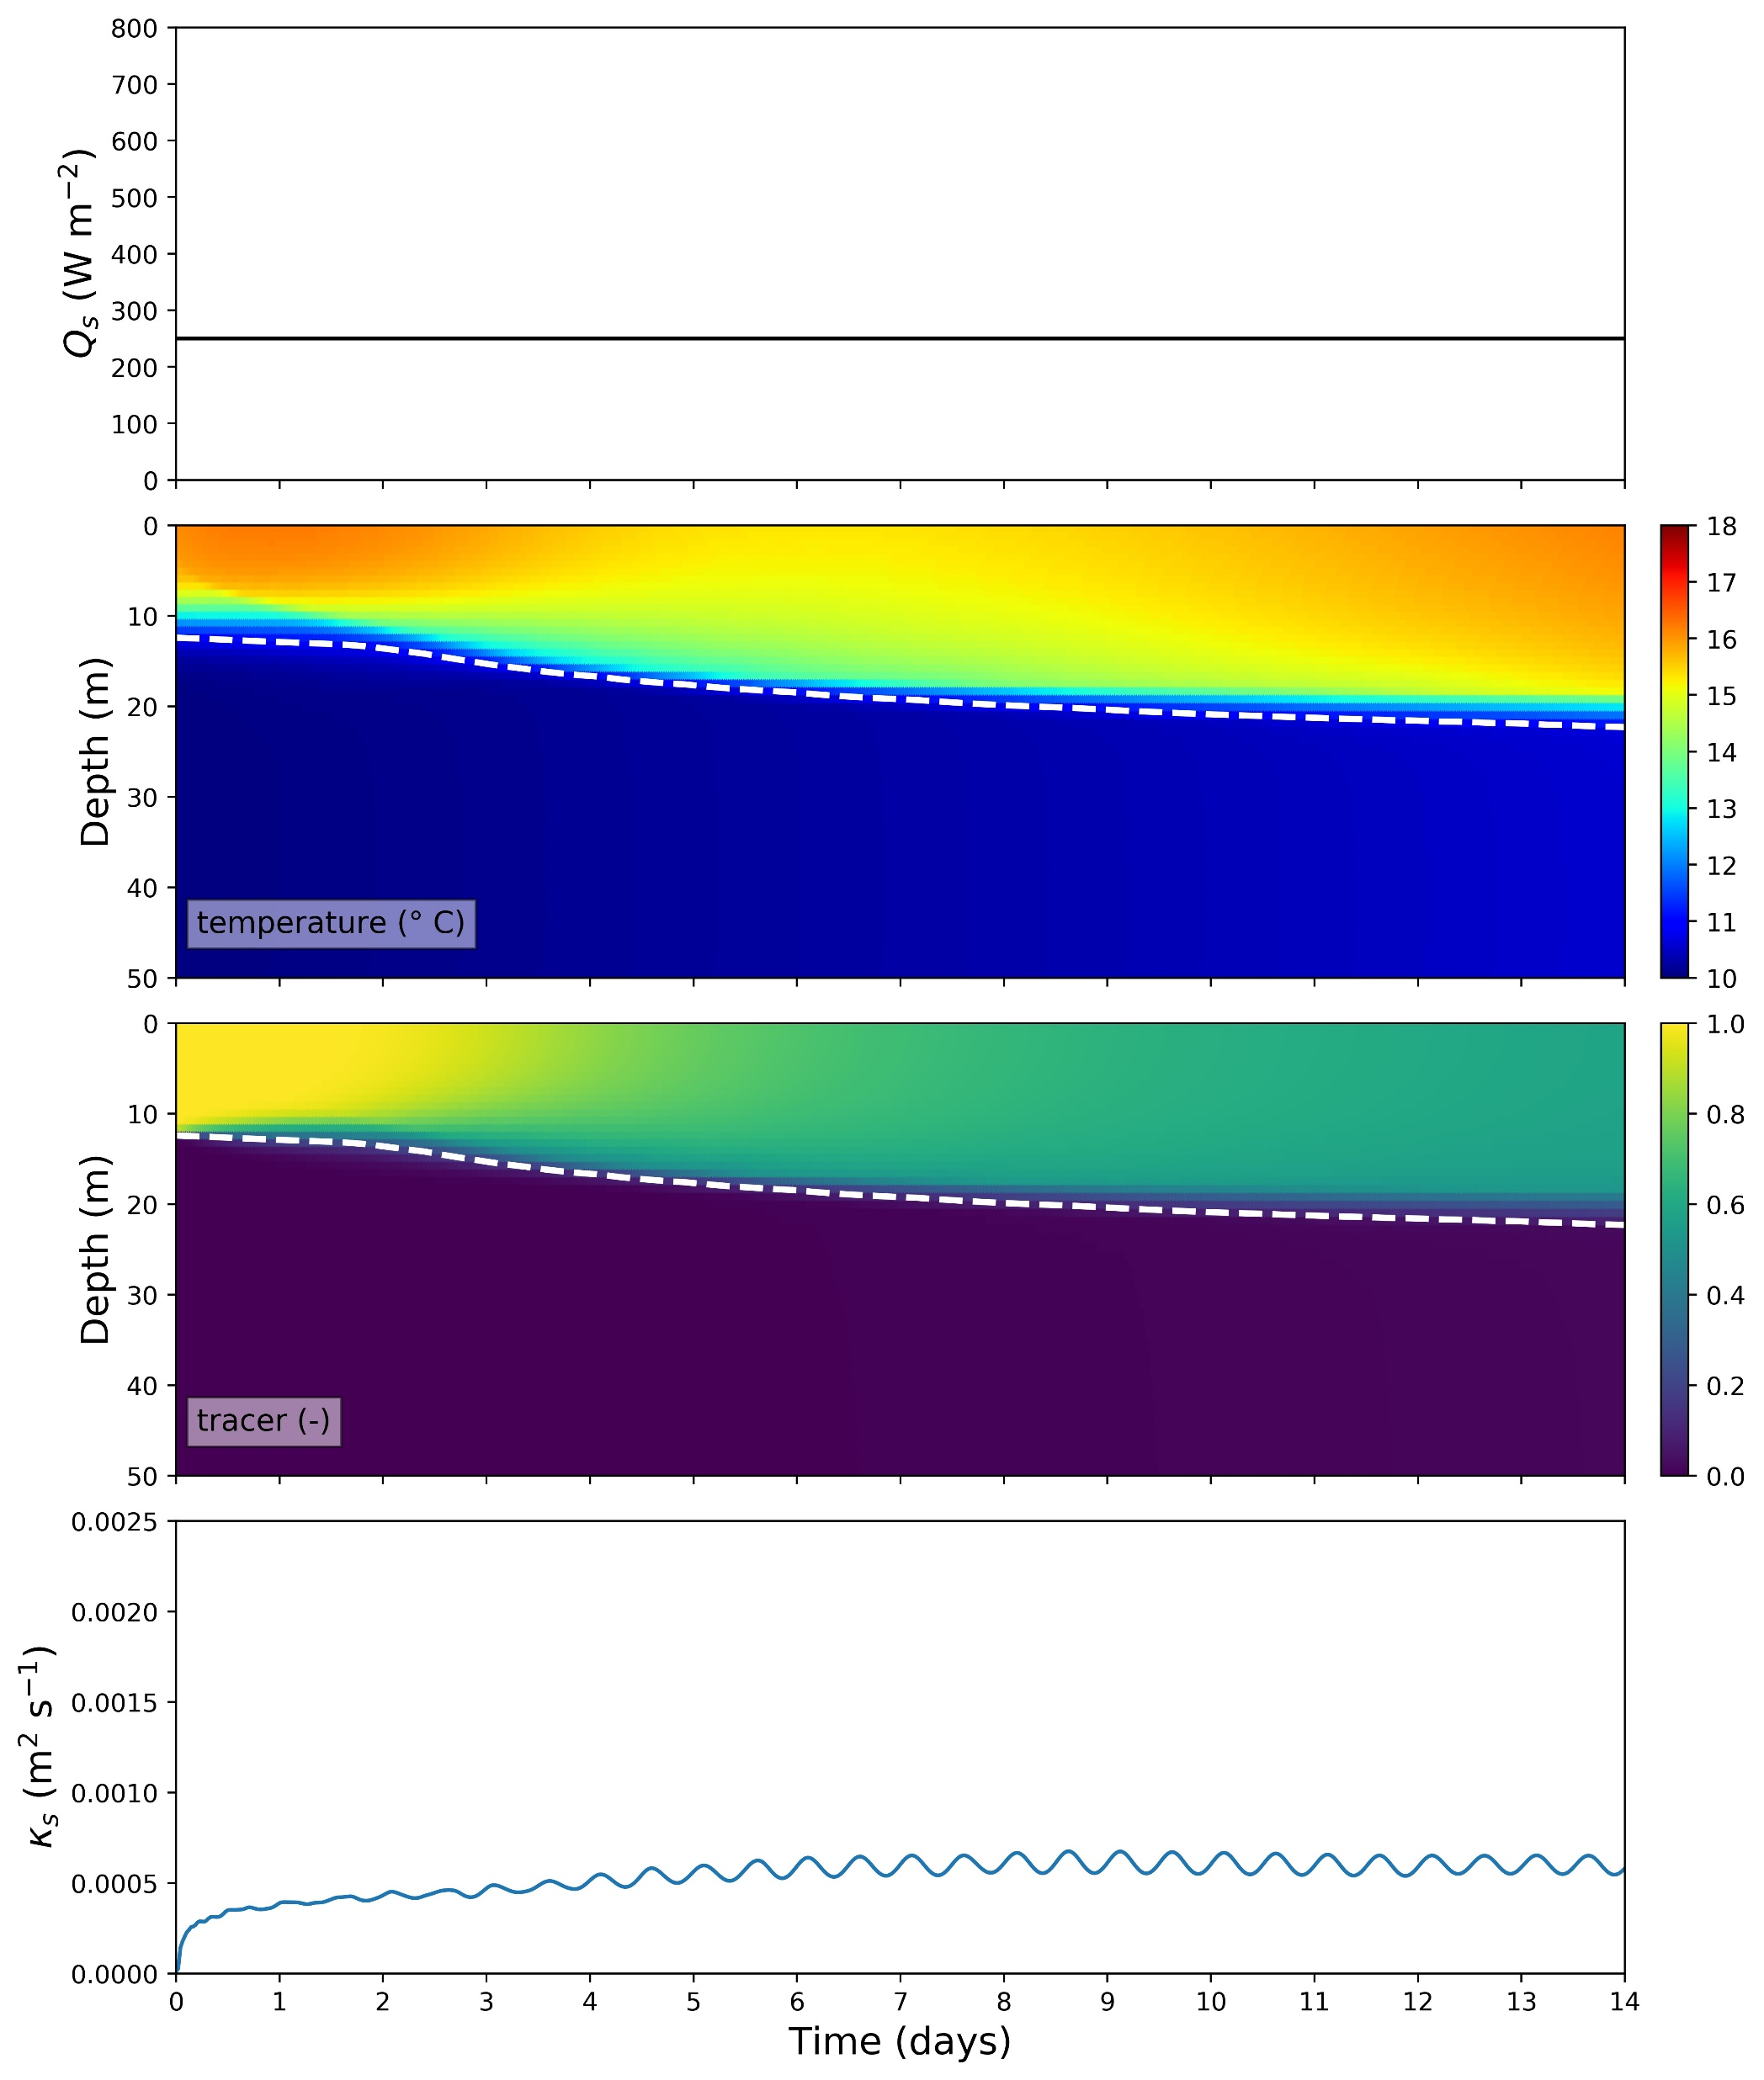
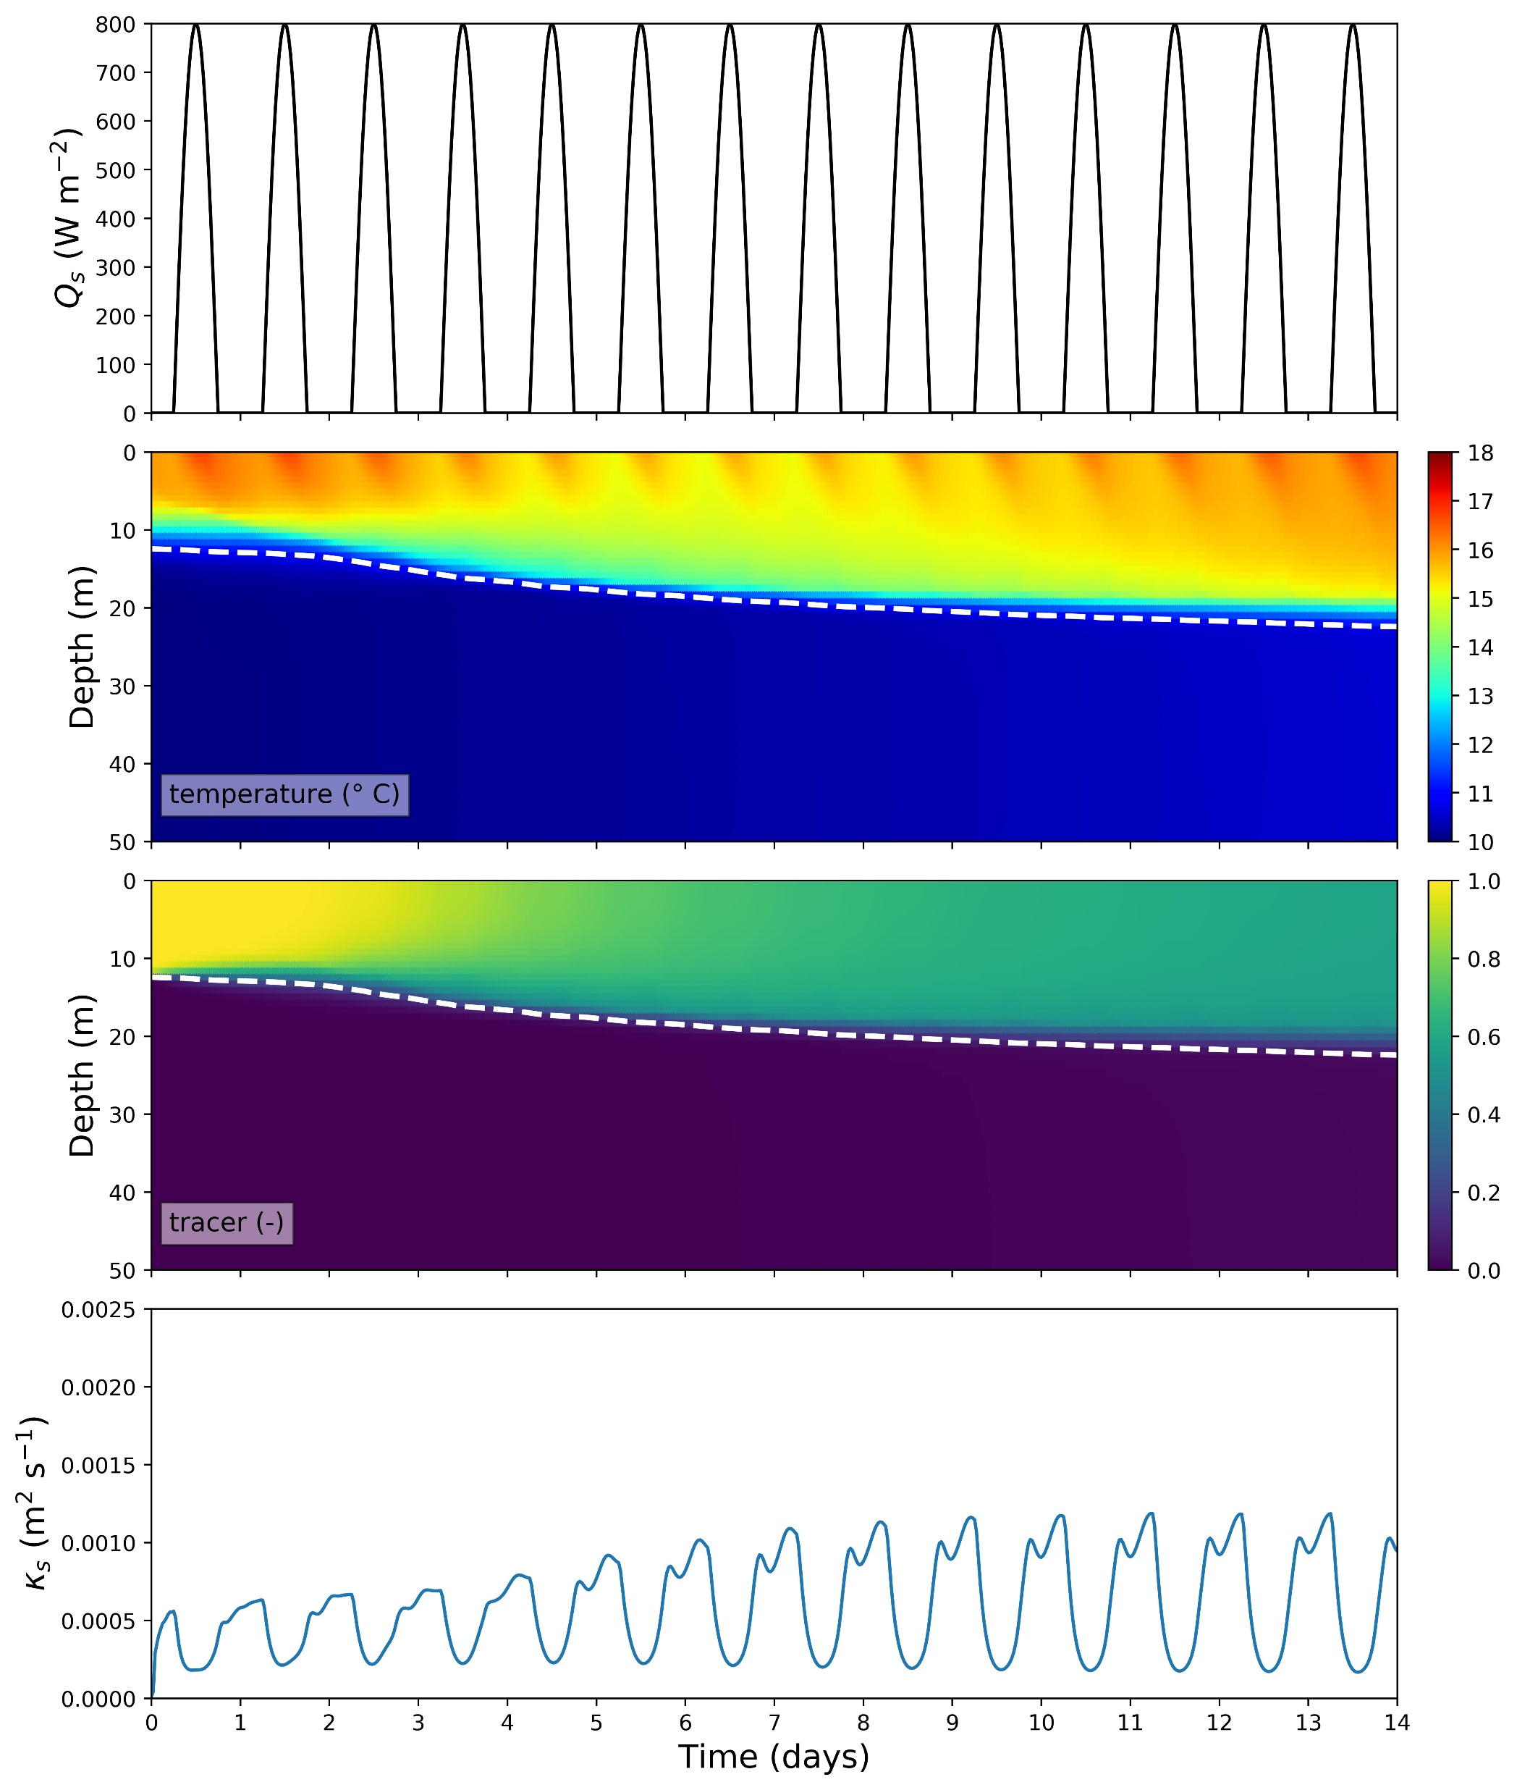
Impact of diurnal surface heat fluxes
τ^{ac0} = 0.03 N m⁻², τ^{mean} = 0 N m⁻²
τ^{ac0} = 0.03 N m⁻², τ^{mean} = 0 N m⁻²

Slide 10
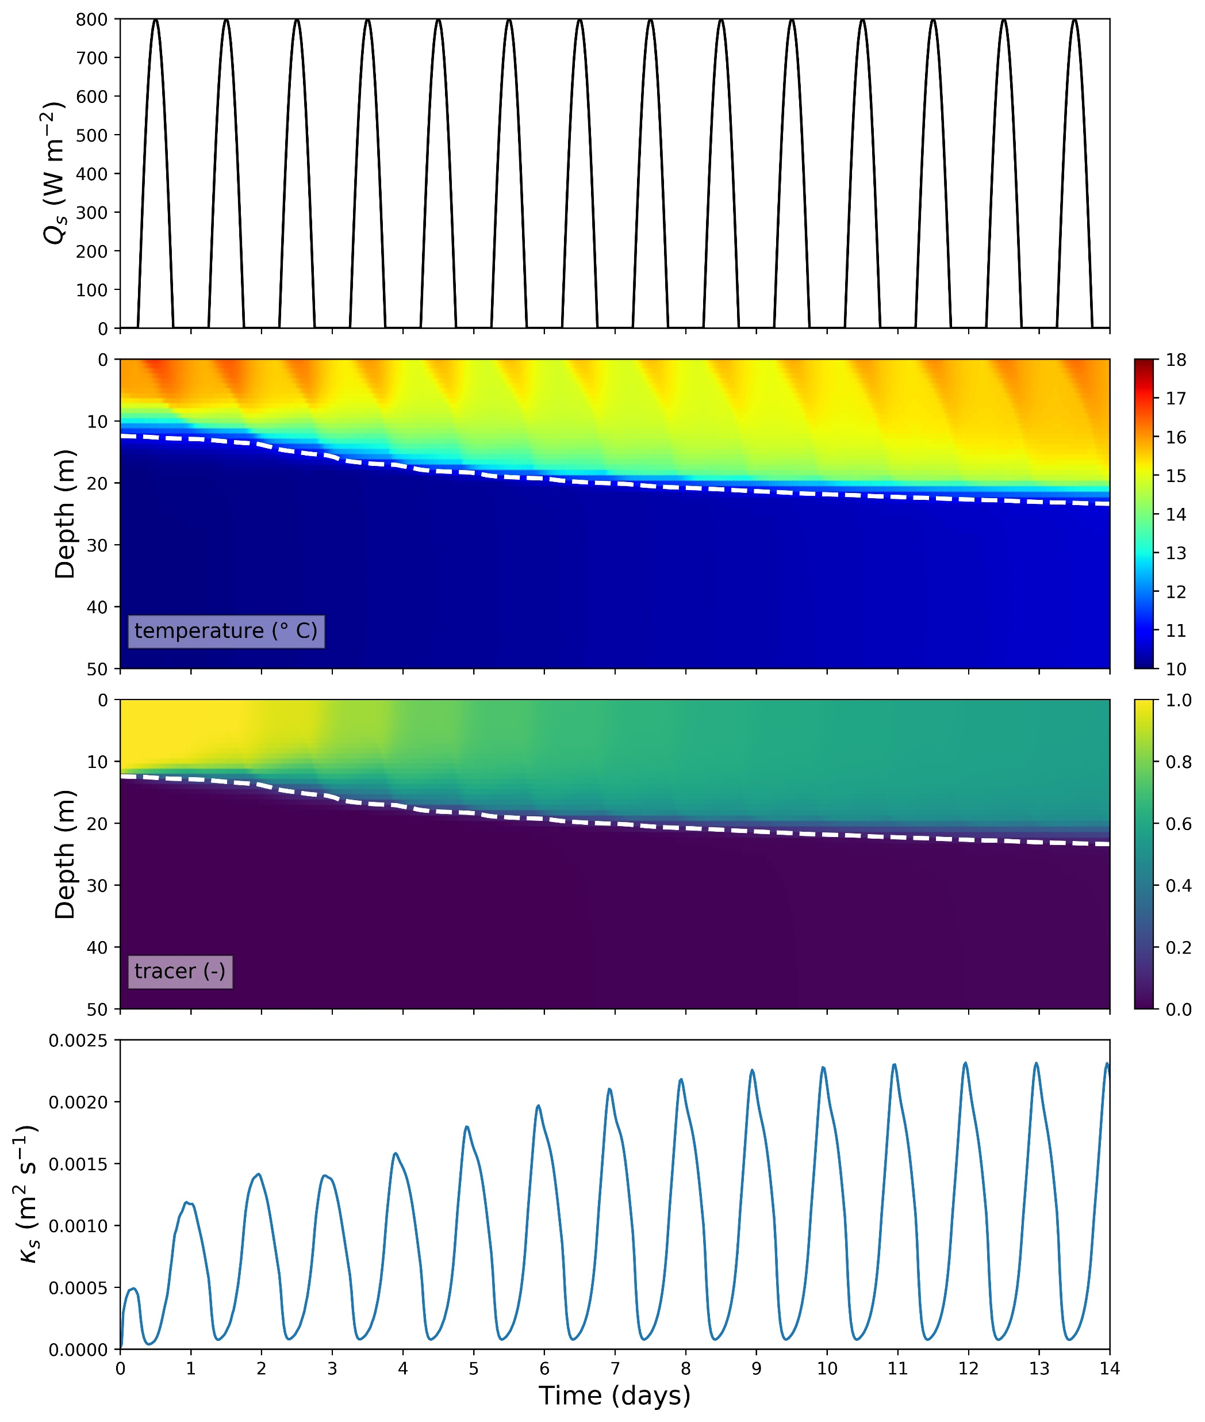
Impact of diurnal surface heat fluxes and a mean alongshore wind stress
τ^{ac0} = 0.03 N m⁻², τ^{mean} = 0 N m⁻²
τ^{ac0} = 0.03 N m⁻², τ^{mean} = 0.05 N m⁻²

Slide 11
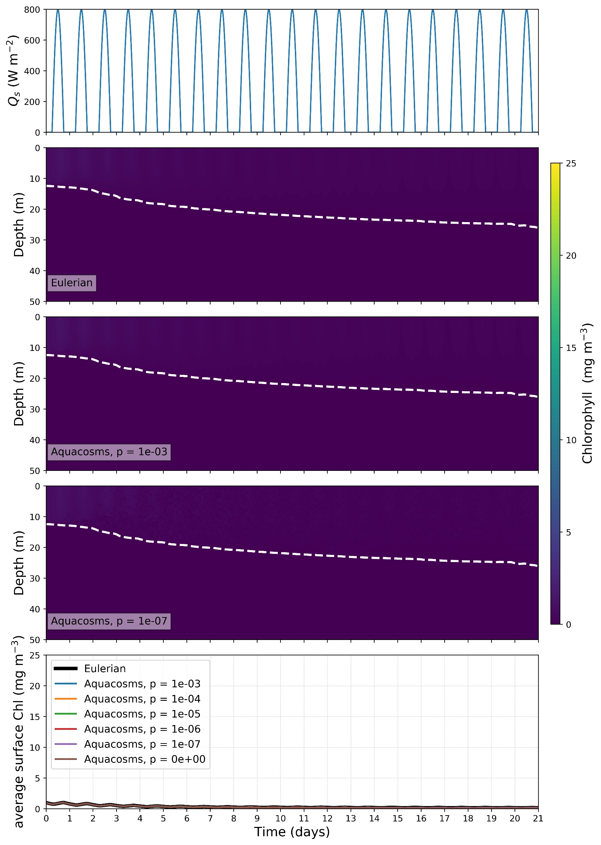
τ^{ac0} = 0.03 N m⁻², τ^{mean} = 0.05 N m⁻²
BioShading_onlyC
Initial Chl (L) condition – 1 mg m⁻³ in surface layer, 0 mg m⁻³ in subsurface. Initial Carbon (C) = L / θ_{chl}
where
where
where
where
Model settings:
θ_{chl} = 0.017
r = 2 days⁻¹
λ_{w} = 1/5 m⁻¹ (as per Sverdrup experiments)
c = 0 m² mg chl⁻¹ (i.e. no bioshading)
b = 0.16 days⁻¹
a = 1 days⁻¹
,

Slide 12
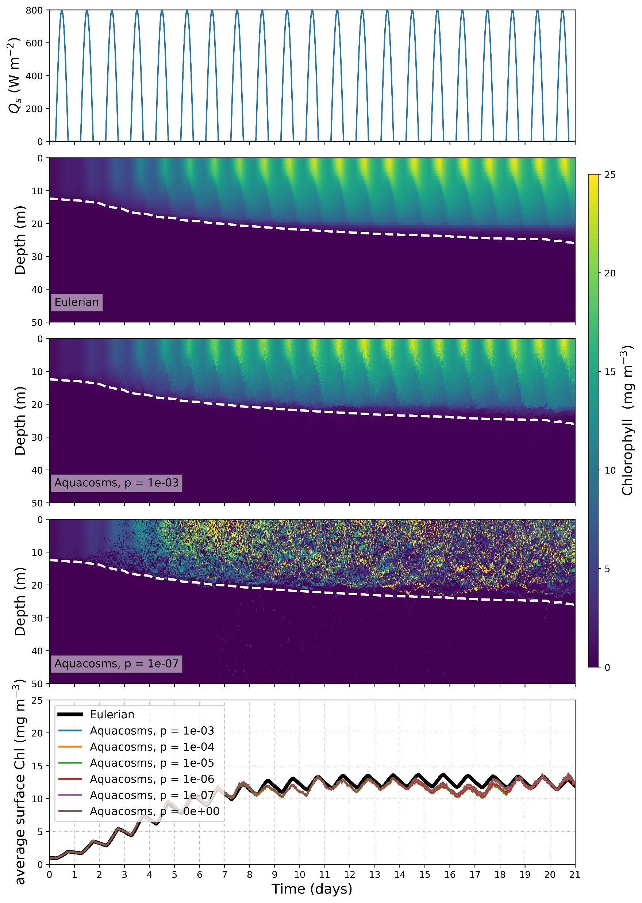
τ^{ac0} = 0.03 N m⁻², τ^{mean} = 0.05 N m⁻²
BioShading_onlyC
Initial Chl (L) condition – 1 mg m⁻³ in surface layer, 0 mg m⁻³ in subsurface. Initial Carbon (C) = L / θ_{chl}
where
where
where
where
Model settings:
θ_{chl} = 0.017
r = 2 days⁻¹
λ_{w} = 1/23 m⁻¹ (clear water)
c = 0.03 m² mg chl⁻¹ (i.e. including bioshading)
b = 0.16 days⁻¹
a = 0.1 days⁻¹
,

Slide 13
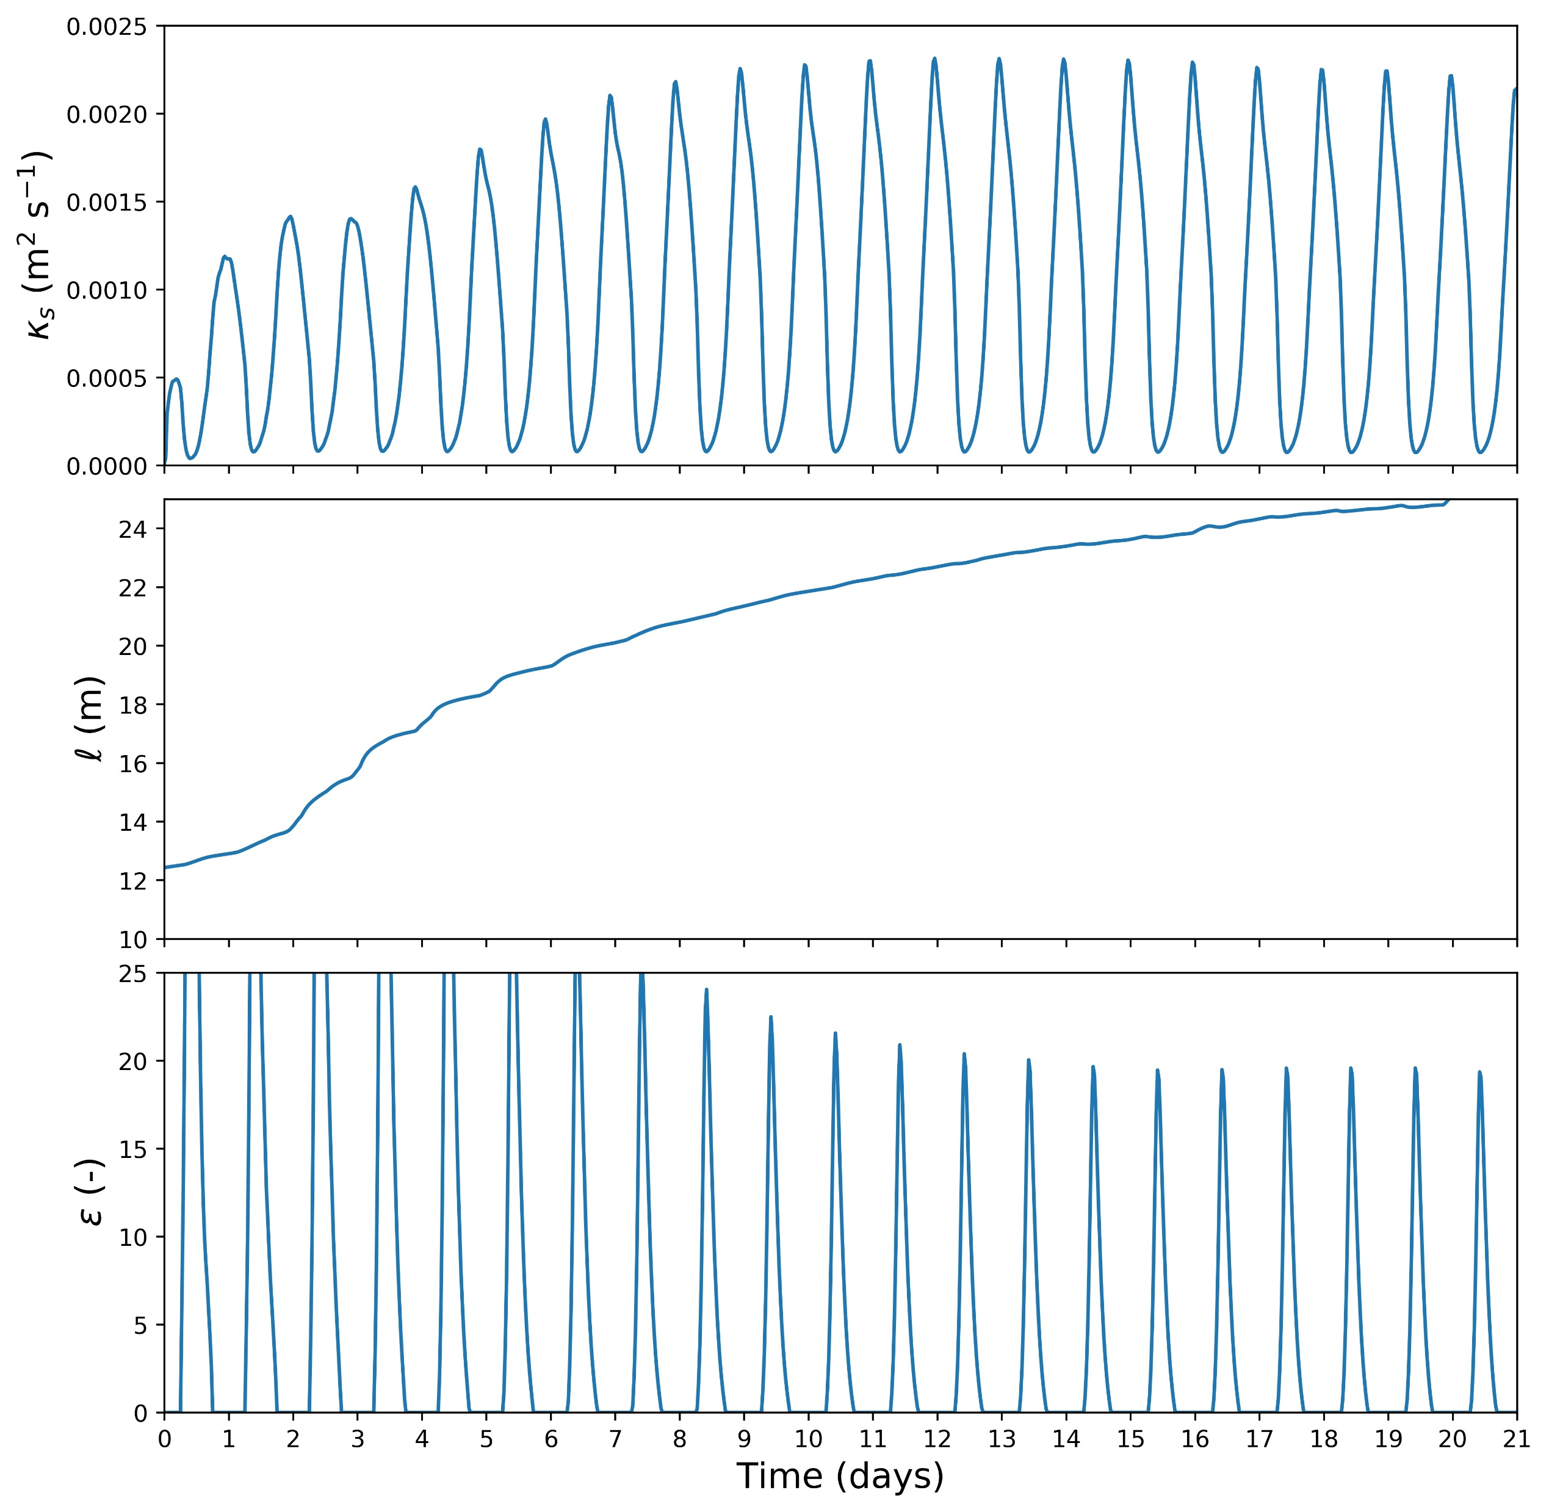
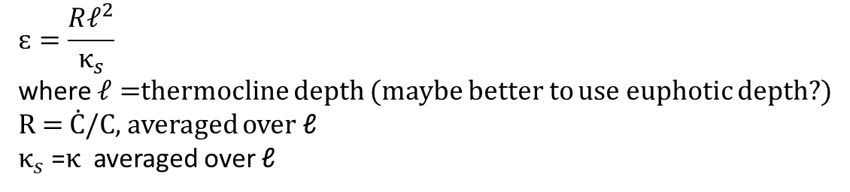
$$ԑ=\frac{Rℓ^{2}}{κ_{s}}$$
where $ℓ=$thermocline depth (maybe better to use euphotic depth?)
R = Ċ/C, averaged over ℓ
$κ_{s}$ =$κ$ averaged over ℓ
BioShading_onlyC
Initial Chl (L) condition – 1 mg m⁻³ in surface layer, 0 mg m⁻³ in subsurface. Initial Carbon (C) = L / θ_{chl}
where
where
where
where
Model settings:
θ_{chl} = 0.017
r = 2 days⁻¹
λ_{w} = 1/23 m⁻¹ (clear water)
c = 0.03 m² mg chl⁻¹ (i.e. including bioshading)
b = 0.16 days⁻¹
a = 0.1 days⁻¹
,

